Slide 1
Programming in Scratch
Lesson 1: Introduction to the Scratch environment and sequencing

Slide 2
Objectives
In this lesson, you will learn how to:
define sequencing
use sequencing in a program
construct a working program to solve a problem.

Slide 3
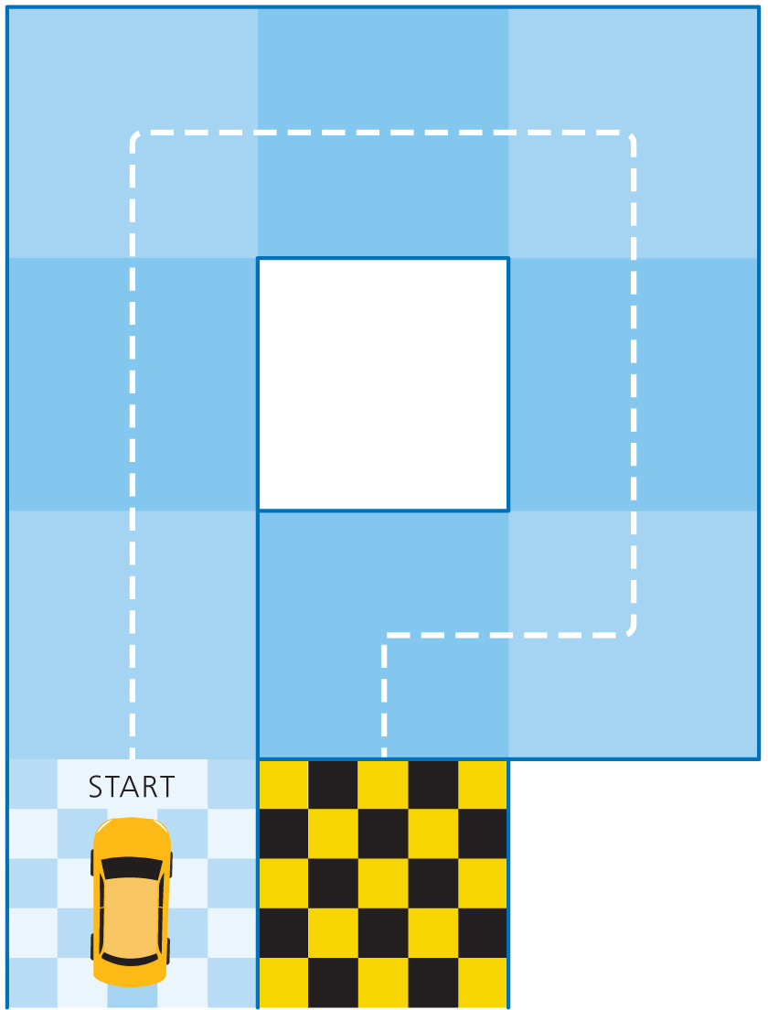
Racing car
Write a sequence of instructions that will get the car from the start to the chequered flag. The only commands the car understands are:
Move X square(s) forward
Turn X degrees right
Turn X degrees left

Slide 4
Programming constructs
In this module, you will learn about the three programming constructs:
Sequence
Selection
Iteration
These three concepts are crucial in allowing us to solve problems, when programming and in day-to-day life.
We will start by focusing on sequencing.

Slide 5
Sequencing
Sequencing is when a set of instructions is carried out in order.
Sequencing is important because, if your instructions are in the wrong order, what you want to happen won’t happen!
What is wrong with the sequence of these instructions to find the average of three numbers?
Total = number 1 + number 2 + number 3
Enter number 1
Enter number 3
Enter number 2
Mean = Total / 3
Display Mean

Slide 6
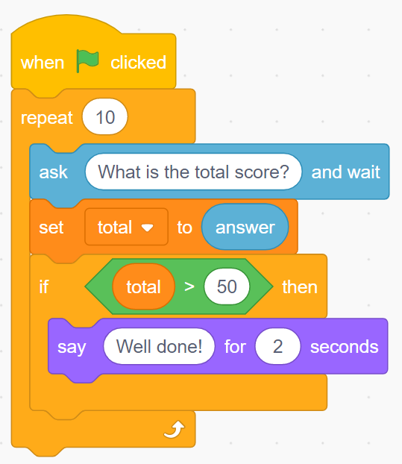
What is Scratch?
Scratch is a program that allows you to piece blocks of code together to solve problems.
It is a block-based programming language because you do not need to type any code.
This is what blocks in Scratch look like:
Now watch Video 5.1

Slide 7

Activity 1.1: Your first Scratch program

Slide 8
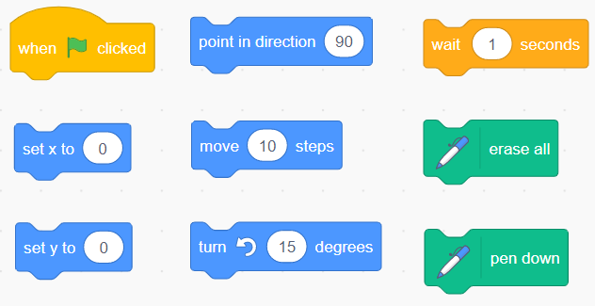
The pen extension
Here are the blocks you will need to use:
The pen extension allows the cat to draw different shapes. You will be using sequencing to draw different shapes.

Slide 9
Activity 1.2: Using the pen to draw shapes

Slide 10
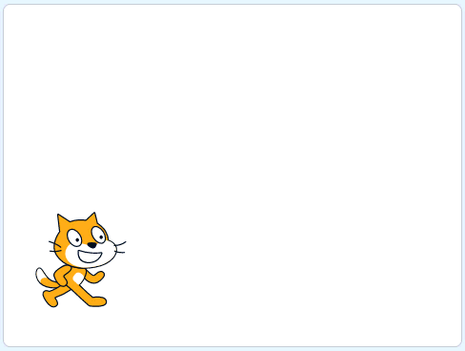

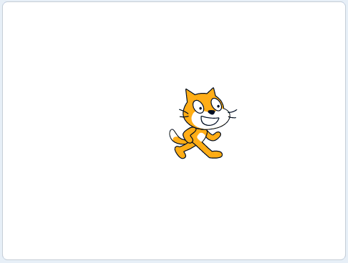
Activity 1.3: Drawing a square
Example of finished solution
Example of extension 1
Example of extension 2

Slide 11
Question 1
What is sequencing?

Slide 12
Question 2
What is the name of the area in Scratch where you can view your program running?

Slide 13
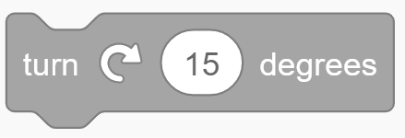
Question 3
In which category would you find the block to change direction?

Slide 14
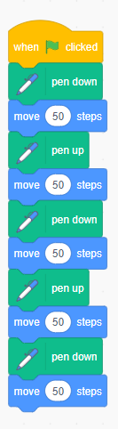
Question 4
What would the following code do?

Slide 15
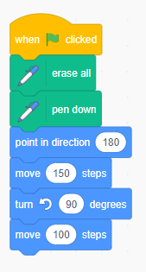
Question 5
What would the following code do?

Slide 16
Quiz 1

